Slide 1

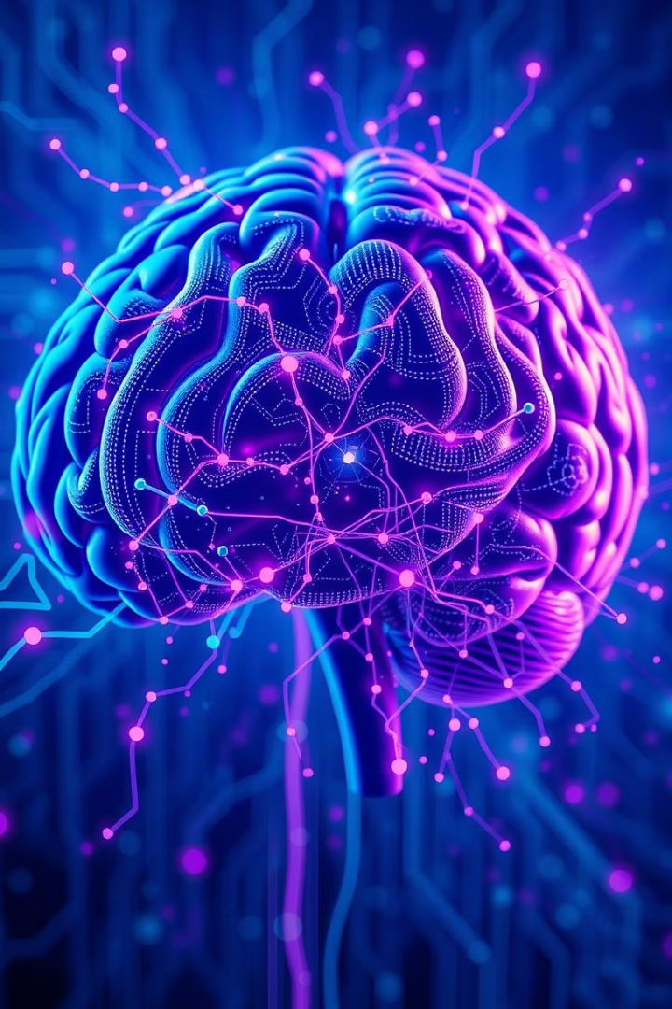

Mental Health Prediction on Social Media Using NLP, ANN & BERT
This presentation explores how advanced AI helps predict mental health challenges. We will delve into NLP, ANN, and BERT. Our goal is early detection and support.
Notes:
1

Slide 2




The Growing Mental Health Crisis: Why Early Detection Matters
Rising Prevalence
Early Intervention
Mental health issues are increasing globally. Many individuals suffer in silence.
Early detection significantly improves treatment outcomes. It can prevent severe crises.
Societal Impact
Unaddressed mental health impacts communities. It affects productivity and well-being.
Notes:
2

Slide 3
Introduction to Natural Language Processing (NLP) for Mental Health
What is NLP?
NLP in Mental Health
NLP enables computers to understand human language. It processes text and speech.
Analyzes social media posts for language patterns. Identifies indicators of distress. It flags concerning keywords.
Text analysis
Sentiment extraction
Emotion detection
Contextual understanding
Depression cues
Anxiety patterns
Notes:
3

Slide 4
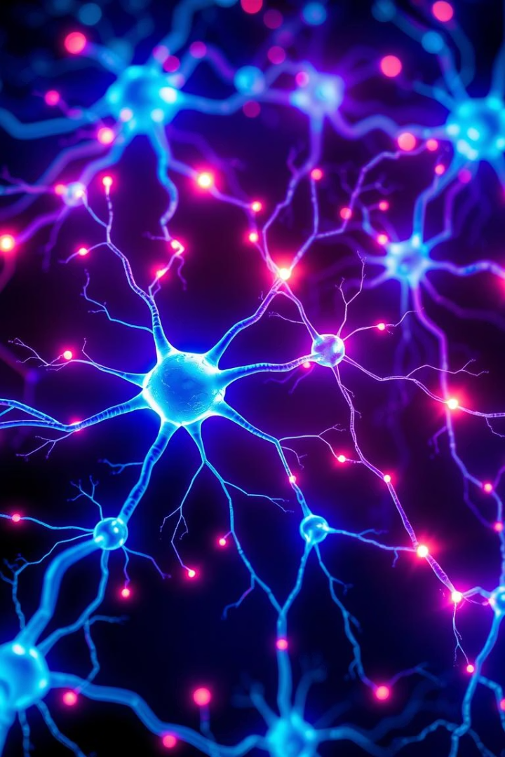




Artificial Neural Networks (ANN) for Sentiment Analysis
Input Layer
Receives processed text data. Each word or phrase becomes a node.
Hidden Layers
Complex computations occur here. Patterns and relationships are identified.
Output Layer
Generates sentiment scores. Categorizes text as positive, negative, or neutral.
Predictive Power
ANNs learn to associate linguistic cues with emotional states. They detect subtle shifts.
Notes:
4

Slide 5




BERT: A Deep Dive into Transformer Models
Fine-tuning
Pre-training
Adapts to specific tasks. Achieves high accuracy in sentiment analysis.
BERT learns language context. It processes vast text corpora.
Bidirectional Context
Understands words based on their full context. Both left and right neighbors are considered.
Notes:
5

Slide 6

Data Collection & Preprocessing from Social Media Platforms
Consent & Anonymity
Obtain user consent where possible. Ensure data is fully anonymized.
Data Extraction
Collect public posts from platforms like Twitter. Use APIs responsibly.
Cleaning & Normalization
Remove irrelevant content and noise. Standardize text for analysis.
Tokenization
Break text into smaller units. Prepare data for model input.
Notes:
6

Slide 7

Model Training & Evaluation: Metrics and Challenges
90%
0.85
Accuracy
F1 Score
Measure of correct predictions. High accuracy is crucial.
Balances precision and recall. Important for imbalanced datasets.
100K+
Dataset Size
Larger datasets improve model generalization. More data leads to better performance.
Training involves feeding preprocessed data to the models. We use metrics like accuracy and F1 score for evaluation. Challenges include data imbalance and evolving language. Bias in data can lead to skewed results.
Notes:
7

Slide 8

Case Study 1: Predicting Depression Risk Using Twitter Data
Methodology
Key Findings
Impact
Collected anonymized tweets. Used NLP to extract linguistic features. Trained an ANN model to identify depression indicators.
Identified specific linguistic patterns. Increased use of negative sentiment words. Higher prevalence of self-referential language.
Demonstrated feasibility of early detection. Potential for proactive support systems. Provided valuable insights into language use.
Notes:
8

Slide 9








Ethical Considerations & Privacy Concerns in Mental Health AI
Privacy
Bias
Protecting user data is paramount. Anonymization techniques are essential.
Models can perpetuate societal biases. Fair and equitable algorithms are critical.
Security
Misdiagnosis
Safeguarding sensitive mental health data. Strong cybersecurity measures are required.
AI is a tool, not a diagnostic replacement. Human oversight is always necessary.
Notes:
9

Slide 10
Conclusion: Future Directions and Impact
Our exploration highlights the potential of AI in mental health. NLP, ANN, and BERT offer promising avenues. They can assist in early detection. Future work includes multimodal data fusion. We aim for real-time monitoring and personalized interventions. This technology can revolutionize mental health support, making it more accessible and proactive.
Key takeaways:
AI enhances early detection.
Ethical guidelines are crucial.
Collaboration is key for impact.
Notes:
10

